Slide 1
MagLev Fan
Motor based on magnetic levitation concept
Submitted by:
THANWEER GAFOOR
PROJECT GUIDE
AMEEN.K.B
ALI ISHAQUE
FARISHA.M.A
MUHAMED AFSAL.V.P
VISHNU.M

Slide 2
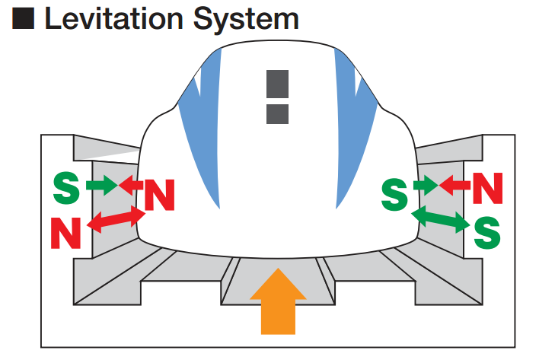
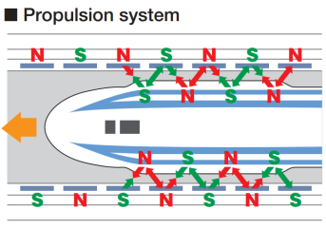
MAGLEV FAN (MOTOR BASED ON MAGNETIC LEVITATION CONCEPT)
WORKING PRINCIPLE: MAGNETIC LEVITATION
Magnetic levitation, maglev, or magnetic suspension is a method by which an object is suspended with no support other than magnetic fields. Magnetic force is used to counteract the effects of the gravitational acceleration and any other accelerations.

Slide 3
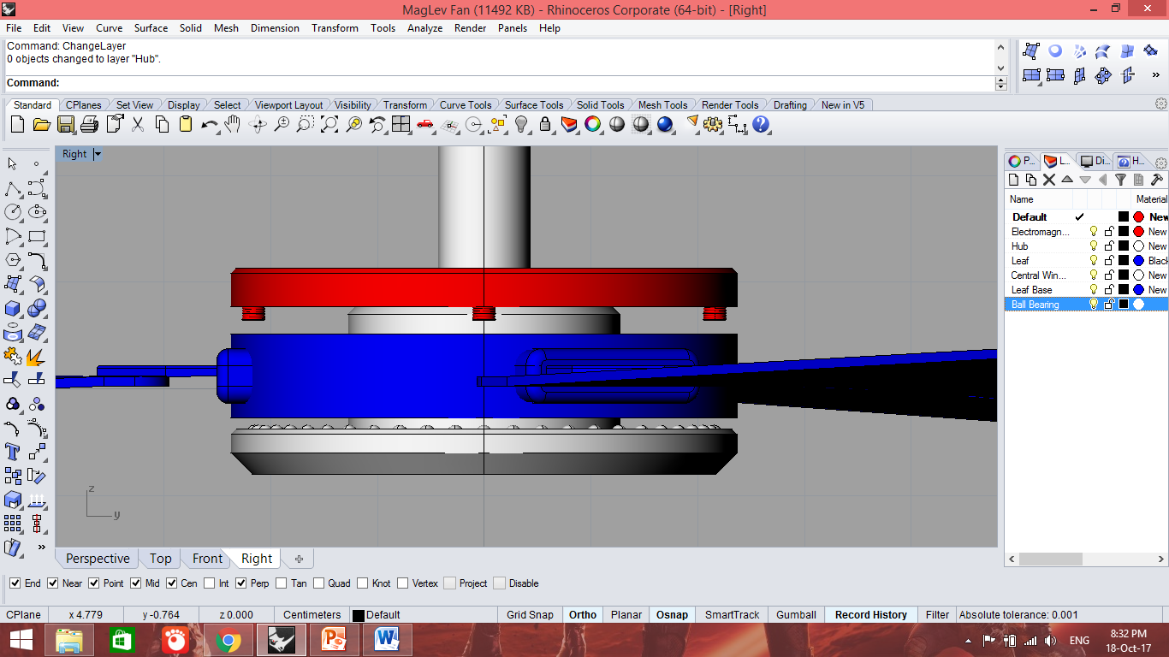
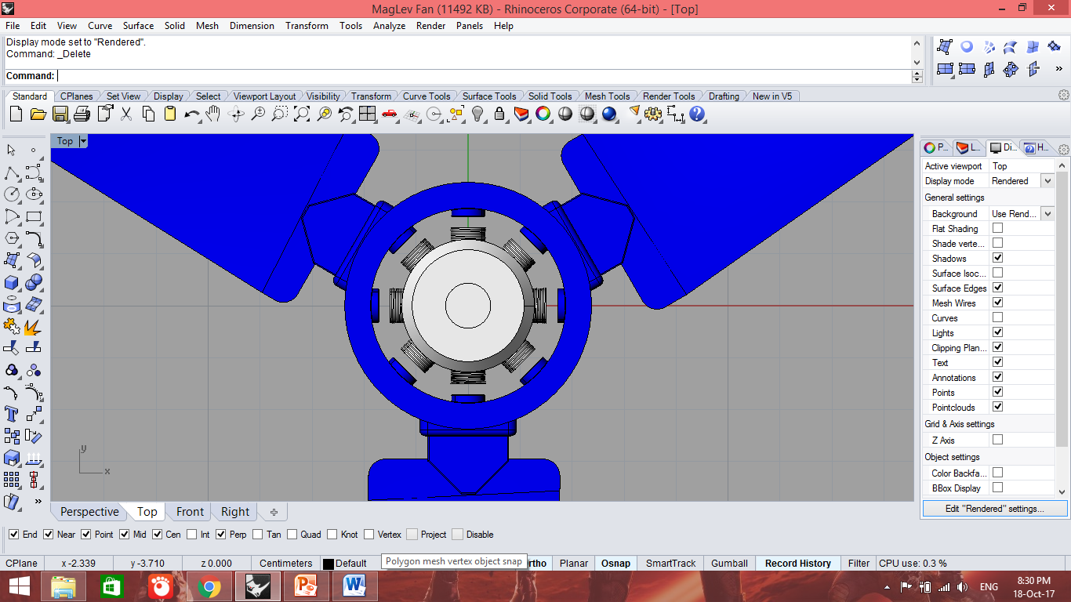
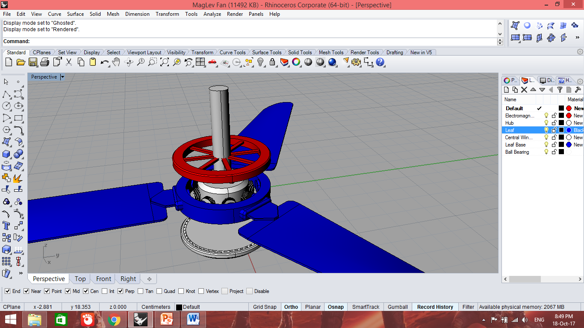
DESIGN
Electromagnets
Rotor and Leaves
Stator and Windings

Slide 4
INNOVATION & TECHNICAL FEASIBLITY
High speed rotation is possible
Losses due to friction, heating and iron losses will be low.
Working parts are independent of controlling circuit
Sound noise will be low
Low cost and commercially feasible
Outer casing for the fan is unnecessary, as dust caps are provided to prevent dust penetration

Slide 5
Social relevance
LESS FRICTION, THUS HIGH SPEED
LONG LIFE AND LESS MAINTAINANCE
LOW POWER CONSUMPTION
GOOD BALANCE, STABILITY AND LESS WUBBLING
NO HEATING ISSUE AND ZERO LOSS DUE TO FRICTION

Slide 6
potential market and commercial viability
It catches potential market and provide commercial viability due to the following reasons:
Lower power consumption
Reasonable price compared to conventional fans
Better technology and aesthetic appearance
Simple speed regulation as that of the conventional fans.
Easy maintenance and fixing

Slide 7
BLOCK DIAGRAM
AC Supply
Speed Control Circuit
Voltage Regulation
Stator
Voltage Control Circuit
Magnetic Field formation
Electromagnets
Rotation
Magnetization
Levitation
Rotor
Components
Process

Slide 8
Components Required
220v 50Hz AC Electromagnets: 4-6
Speed control capacitors: 1uF, 1.5uF, 2uF
AC fan capacitor: 2.5uF
Copper wire for main and auxiliary windings
Steel ball bearings
Electric steel sheet for stator and rotor poles
Non corrosive iron for rotor base
Connection wires

Slide 9
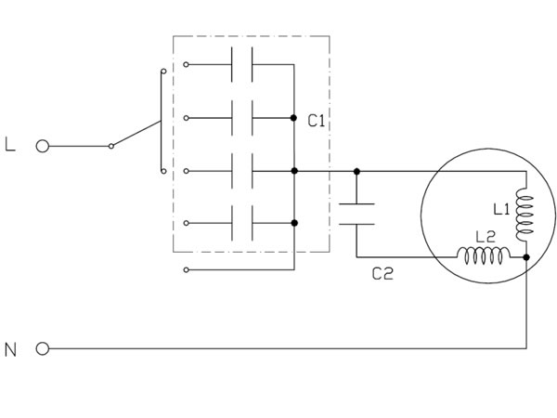
Speed control
A variable capacitance in is used in this regulator.
As we turn the knob the capacitance increases and it reduces the voltage available to the fan.
There is nearly no power loss in this method.
The losses incurred are due to resistive losses inside the capacitor which is negligible.
There are no heating problems and the capacitor improves the power factor of the circuit.
They are less bulky than resistive controllers.

Slide 10
Technical feasibility
The cost of production of the prototype will be as follows:
Copper Wire : ₹ 1000
Metal parts: Iron : ₹ 1000
Metal parts: Steel : ₹ 1500
Electromagnetic components : ₹ 2000
Auxiliary parts : ₹ 1000
Electronic components
Regulator : ₹ 350
Capacitor : ₹ 50
Connection wires : ₹ 100
Labor charges : ₹ 500
Miscellaneous costs : ₹ 500
Total cost : ₹ 8000
The cost of industrial production will be as follows:
Copper Wire : ₹ 1000
Metal parts: Iron : ₹ 500
Metal parts: Steel : ₹ 500
Electromagnetic components : ₹ 500
Labor charges : ₹ 500
Total cost : ₹ 2500

Slide 11
Current status and action plan
Works completed
Project cost estimation
Project overall rough design
Design of electronic control system
Improvement in design with torque damping dust caps
Project presentation

Slide 12
Current status and action plan
Works Under Process
Design of electromagnets
Overall electronic circuit design
Techniques for maximum cost reduction
Research using existing Semi-Maglev fans

Slide 13
Current status and action plan
Future plans in chronological order
November 2017 : Complete design with final clear cut cost estimation and simulation
December 2017 : Purchase of materials, assembly and test runs
January 2018 : Completed product, final touches, design tweaks if any
February 2018 : Design finalization, product completion and experimental tests
March 2018 : Product release

Slide 14
Thank You

